Slide 1

SUMMER INTERNSHIP REPORT
Analysis & Design of Vehicle Chassis in EV’s
Submitted by:
238T5A0202-ANNAVARAPU KOTESWARA RAO
238T5A0203-ARIGA PREM KUMAR
238T5A0211-PULAVARTHI SURESH.
Faculty Mentor:
Dr. GUVURULA NAIDU
ASSISTANT PROFESSOR & HEAD OF THE DEPEARTMENT
ELECTRICAL AND ELECTRONICS ENGINEERING
(Batch No-1)

Slide 2
ABSTRACT:
Electric vehicles (EVs) are gaining popularity worldwide due to their environmental benefits, reduced operating costs, and improved performance. This paper provides an in-depth analysis of EVs, including their types, battery technologies, charging methods, and research challenges. We will explore the current market situation, future prospects, and the role of EVs in smart cities.

Slide 3
INTRODUCTION TO EV’s
History and Evolution EV’s
Classification of EV’s
Main Components in EV’s
Principle of Operation
Merits and Disadvantages

Slide 4
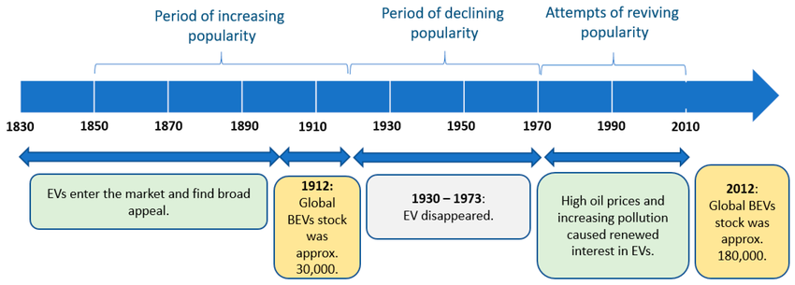
HISTORY OF EV’s:

Slide 5
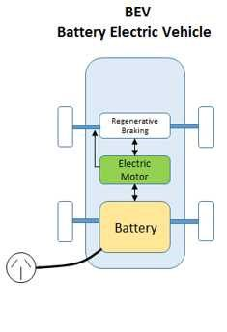
CLASSIFICATIONS:
1. Battery Electric Vehicles (BEVs) :
BEVs are powered by a battery pack and electric motor.
BEVs produce no emissions, reducing air pollution and greenhouse gas emissions.
BEVs can be recharged from an external power source, such as a wall socket or charging station.
BEVs offer a sustainable and environmentally friendly transportation option, with benefits including lower operating costs and reduced dependence on fossil fuels.

Slide 6
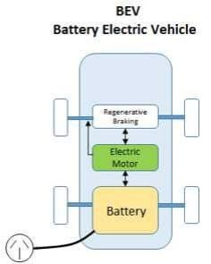
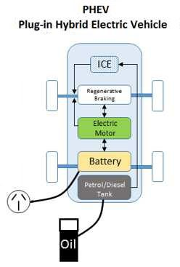
2. Hybrid Electric Vehicle:
HEVs have both an electric motor and a gasoline engine.
HEVs cannot be plugged into an external power source; instead, they recharge their battery through regenerative braking and engine power.
HEVs optimize fuel efficiency by using electric power to assist the gasoline engine.
3. Plug In Hybrid Electric Vehicle(PHEVs):
PHEVs have both an electric motor and a gasoline engine.
PHEVs can be plugged into an external power source to recharge their battery.
PHEVs can run on electric power alone for a certain distance, then switch to gasoline power for extended range.

Slide 7
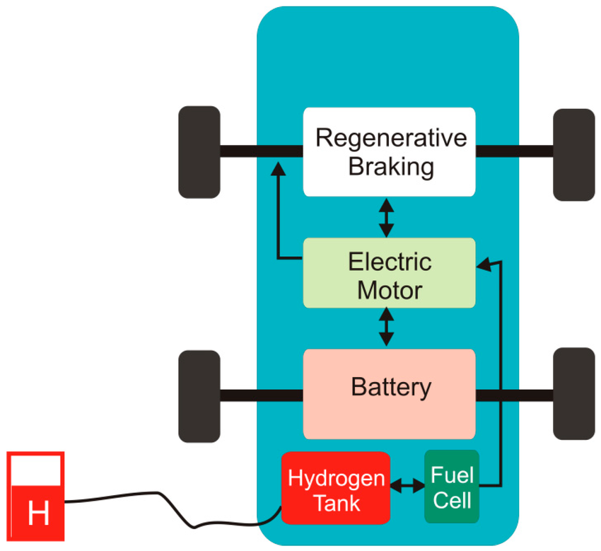
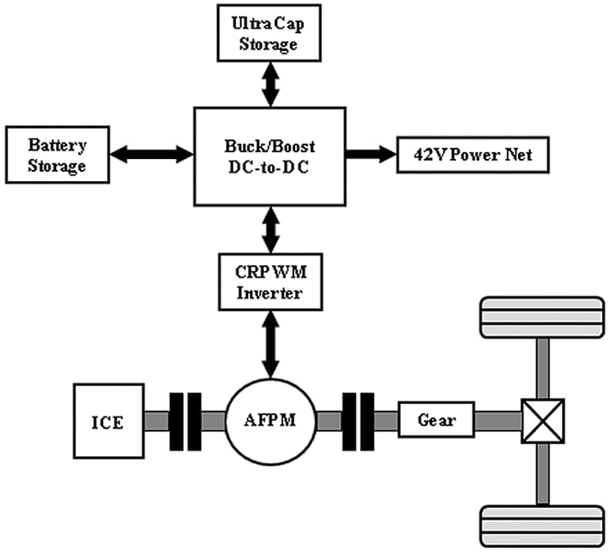
FCEV
4. Fuel Cell Electric Vehicle(FCEVs):
FCEVs generate electricity from hydrogen, which powers an electric motor.
FCEVs produce only water vapor and heat as byproducts.
FCEVs can be refueled quickly, similar to gasoline vehicles.
FCEVs offer a promising alternative to traditional fossil fuel-based transportation, with benefits including reduced greenhouse gas emissions and improved energy efficiency.
5. Mild Hybrid Electric Vehicle(MHEVs):
Electric motor provides additional power during acceleration.
Captures kinetic energy and converts it into electrical energy.
Gasoline engine is always required.
MHEVs offer a balance between fuel efficiency and affordability, making them a popular choice for those seeking a more efficient vehicle.
MHEV

Slide 8
MAIN COMPONENTS IN EV’S
Electric Motor: Converts electrical energy into mechanical energy to propel the vehicle.
Battery Pack: Stores electrical energy for the vehicle, typically using lithium-ion batteries.
Power Electronics Controller: Manages the flow of electrical energy between the battery, motor, and other components.
Charging System: Allows the vehicle to recharge its battery from an external power source.
Transmission: Transfers power from the electric motor to the wheels
Regenerative Braking System: Captures kinetic energy and converts it into electrical energy to recharge the battery.
Battery Management System (BMS): Monitors and controls the battery's state of charge, health, and safety.
Thermal Management System: Regulates the temperature of the battery and other components to ensure optimal performance and longevity.
Chassis &Body:(monocoque or skateboard platform) – Houses the battery pack at the floor for stability.

Slide 9
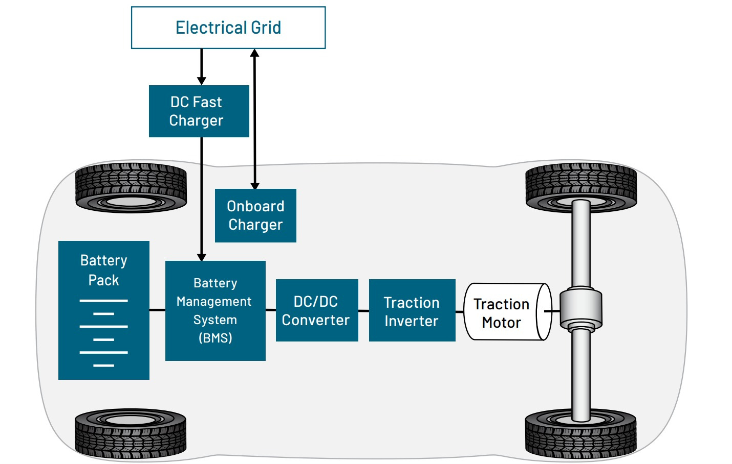
PRINCIPLE OF OPERATION: Electric vehicles operate on the principle of converting electrical energy stored in a battery into mechanical energy to propel the vehicle.
Battery → Power Electronics → Electric Motor → Transmission → Wheels

Slide 10
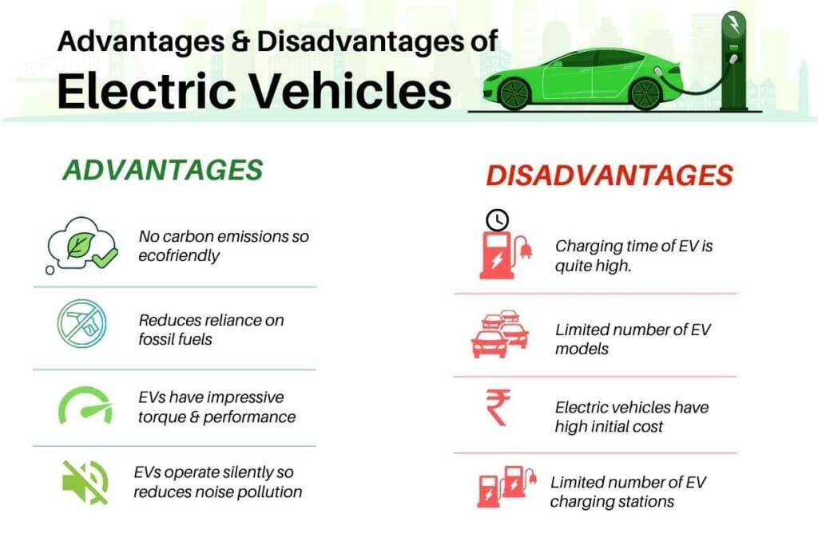

Slide 11


